Slide 1


NUS-ISS-ISY5002-PRS-PracticeModule
MarineVision
Advanced Deep Learning Techniques to Enhance Underwater Video Footages for Improved Marine Object Identification
Ashiwin Rajendran (A0291191E)​
Jithin Krishnan (A0249481W)​
Prem Varijakzhan (A0291913B)​
Shankar Sai Ganesh (A0168149U)​

Slide 2
Enhancing Underwater Imaging: Background, Challenges & Project Objectives
Background
With rapid advances in underwater technology, autonomous and remotely operated vehicles (AUVs and ROVs) have become crucial for exploration, research, and inspection, reducing human risk, lowering costs, and accessing areas beyond human reach.
Beex, a leading company in AUVs, leverages these vehicles to inspect underwater infrastructure and critical structures, relying on visual data from onboard cameras.
However, underwater imaging faces challenges like color distortion, light absorption, motion blur, and noise, all impacting clarity and quality.
Challenges
Objective
Marine Vision project addresses these limitations with an Advanced AI based Underwater Image Enhancement System using CNN and GAN models to enhance image clarity, color balance, and sharpness. This system will improve the quality of AUV data, supporting more accurate inspection and analysis.
Environmental Variability | Color Correction Complexity
Noise and Motion Blur | Artifact Generation
Model Complexity and Real-Time Needs
Develop a Custom CNN & GAN Architecture | Supports Web based application
Evaluate Model Performance | Enhancement for Real time deployment
Model Complexity and Real-Time Needs | Analyze Influencing Factors and Improvements

Slide 3
Tools/Techniques Used
Processing Phase | Process Details
Initial Dataset | Raw video footage from Beex AUV 28,877 frame pairs extracted Resolution: 1920x1080 Frame Rate: 15 FPS
Data Sampling | Reduced to 5,776 unique frames Removed redundant frames Maintained original resolution Optimized for feature extraction
Enhancement Application | Each raw image (5,776) enhanced using: RGHS Method → 5,776 images UCM Method → 5,776 images ICM Method → 5,776 images Company's Method → 5,776 images ICM + Company Method → 5,776 images Total: 28,880 enhanced images (5 versions per raw image)
Unsupervised Selection | Feature extraction performed on all enhanced versions Automatic selection of best enhancement per image Quality metrics comparison Selection of optimal enhancement method per image
Base Dataset | TrainA: 5,776 raw images TrainB: 5,776 best-enhanced images Each TrainB image selected from one of five enhancement methods Optimal pairs determined by unsupervised learning
Training Options
Option 1: Base Dataset Only Use 5,776 proprietary image pairs Focused on specific underwater conditions Option 2: Combined Dataset Base dataset + Public underwater datasets. Enhanced model robustness Flexible training approach for team members. Improved generalization capabilities

Slide 4
Data Preparation Techniques
1. ICM (Integrated Colour Model)
Techniques:
Global Histogram Stretching
HSV Stretching
Scene Radiance Adjustment
Purpose: Enhances contrast and visibility by iteratively refining image clarity.
2. RGHS (Relative Global Histogram Stretching)
Techniques:
RGB Equalization
LAB Stretching
Relative Histogram Adjustment
Purpose: Improves colour balance and segment clarity by adjusting histogram and colour channels.
3. UCM (Unsupervised Color Correction Method)
Techniques:
RGB Equalization
Global Histogram Stretching
HSV Stretching
Purpose: Enhances image contours and boundaries, focusing on both colour and brightness adjustments.

Slide 5
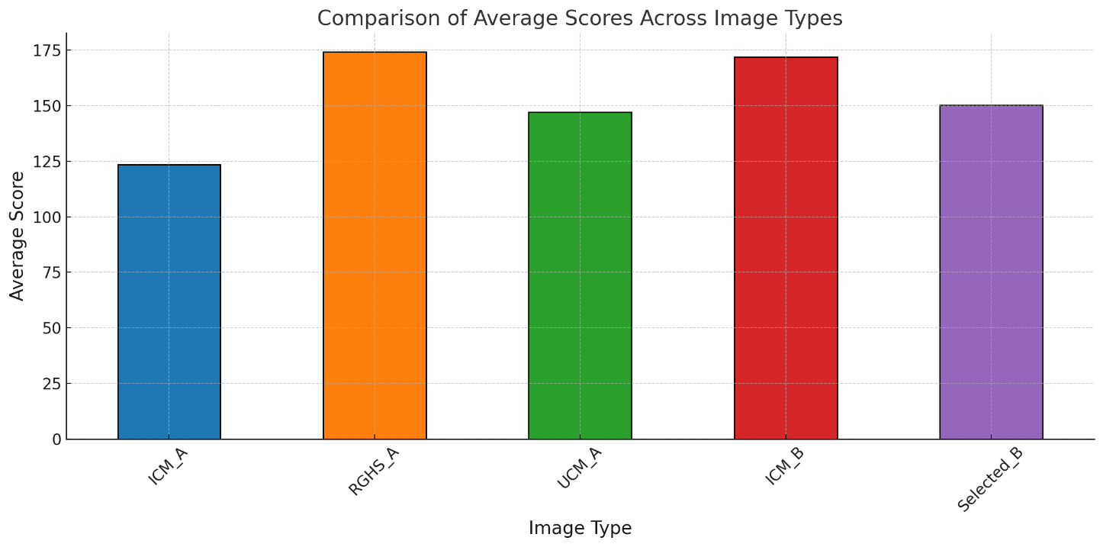
Feature Selection & Selection of final data
Feature Extraction - ResNet50 (Representation Learning)
Feature Combination (Sharpness, Contrast, Brightness)
Filter for Unwanted Colours
DBSCAN Clustering
Select Best Image from Largest Cluster

Slide 6
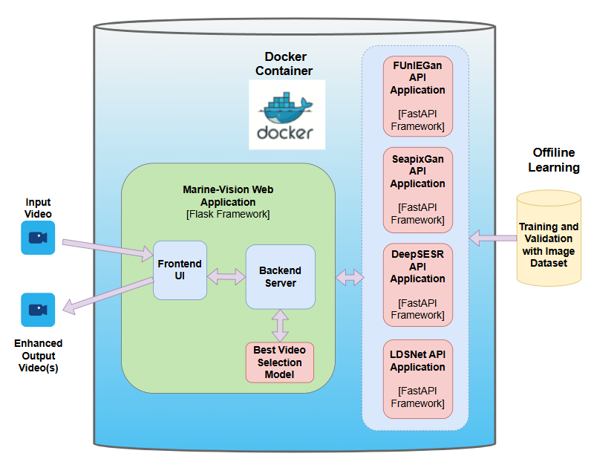
System Architecture
Components:
Docker Container:
Hosts all applications and services in isolated environments for seamless deployment.
Marine-Vision Web Application (Flask Framework):
Frontend UI: Collects input videos and displays enhanced output videos to users.
Backend Server: Manages requests and responses between UI and enhancement models.
Integrates with the Best Video Selection Model to determine the optimal output video.
API Applications (FastAPI Framework):
FUnIEGan, Sea-Pix-GAN, DeepSESr, LDSNet:
Each application provides video enhancement through specific GAN/CNN-based models.
Offline Learning:
Training and validation of models using curated image datasets to improve enhancement quality.

Slide 7
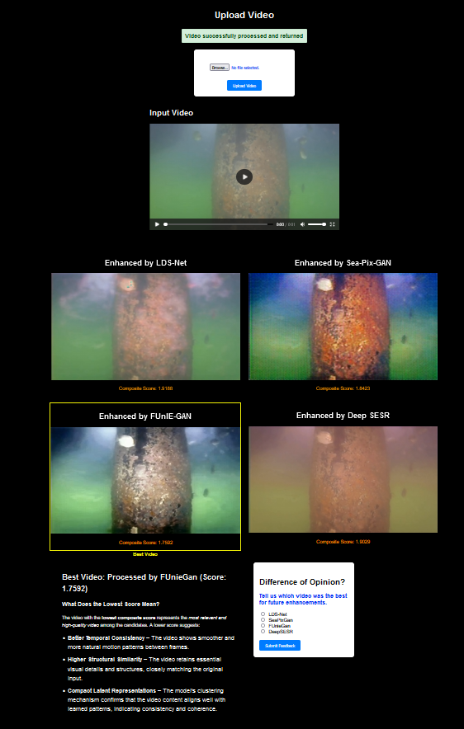
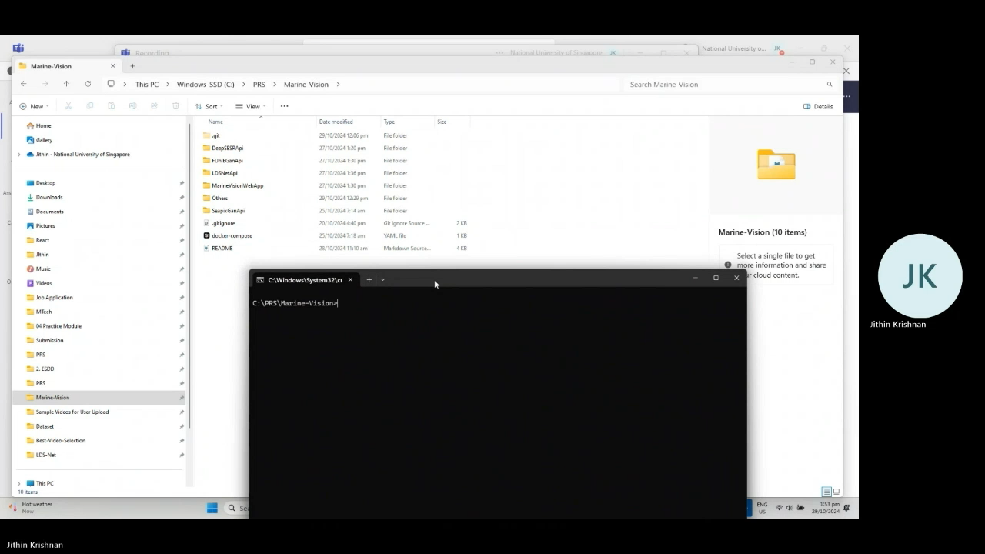
Application Demo
Upload Video
Workflow:
User uploads an input video via the frontend.
Backend server sends the video to multiple model APIs for enhancement.
The Best Video Selection Model determines the highest-quality output.
The enhanced video is sent back to the user via the frontend.
As an optional feature, the user can also provide feedback on the users deemed best video is different
Input Video Displayed
Demo Video pending to be added​
Enhanced Output Videos
System Selected Best Video
Quality Score
Demo Video
Feedback Form

Slide 8
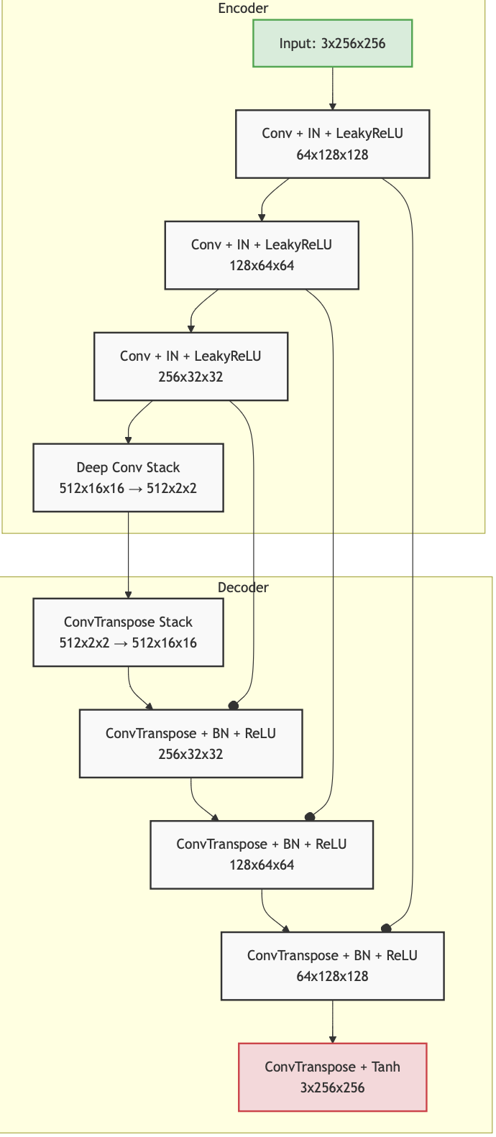
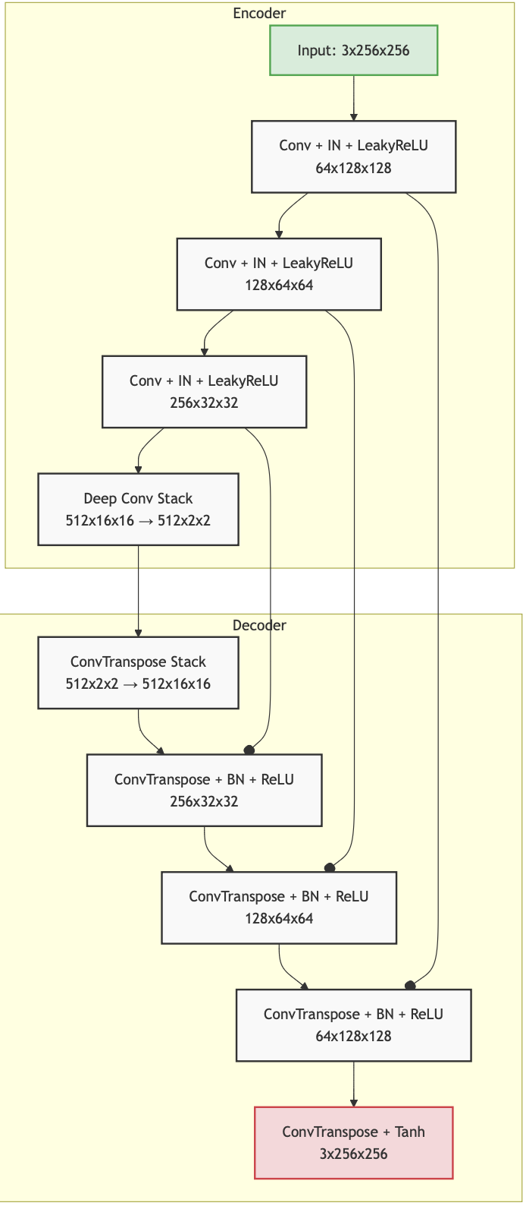
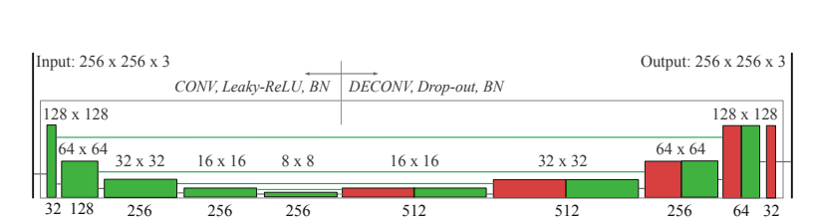
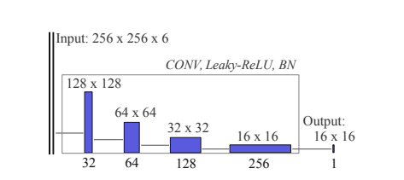
ML Model Architecture
FUnIE-GAN: Fast Underwater Image Enhancement
Sea-Pix-GAN Image Enhancement Model
A Real-time Generative Adversarial Network for Underwater Image Enhancement
Fine Tuning for Sea-Pix-GAN from original Architecture
Encoder-Decoder Structure:
Preserved the original structure with U-Net style skip connections for better feature retention during upsampling.
Normalization:
Replaced Batch Normalization with Instance Normalization in the encoder layers to handle varying styles more effectively and enhance generalization.
Dropout Regularization:
Introduced Dropout layers in the first three decoder layers to improve regularization and prevent overfitting.
Training from Scratch:
Model was trained from scratch, allowing for customized adaptation to underwater images.
Input Size:
Set input size to 256x256, aligning with standard image-to-image translation requirements.
Generator with five encoder and decoder pairs - UGAN -
Discriminator with four layer
- Markovian PatchGAN -
Network Architecture
Generator (UNet-based):
5-layer symmetric encoder-decoder
Skip connections preserve details
Processes 1920×1088×3 images
Uses Instance Normalization
Discriminator:
4-layer PatchGAN design
Evaluates image patches
Ensures local texture quality
Key Characteristics
Training Objectives:
Conditional adversarial loss
L1 loss for global similarity
Content preservation loss
Local texture & style consistency
Advantages:
Optimized for real-time processing
Ideal for AUV applications
Maintains HD dimension 1920 * 1080
Maintains image details & color
Maps distorted underwater images (X) → enhanced images (Y) in real-time

Slide 9
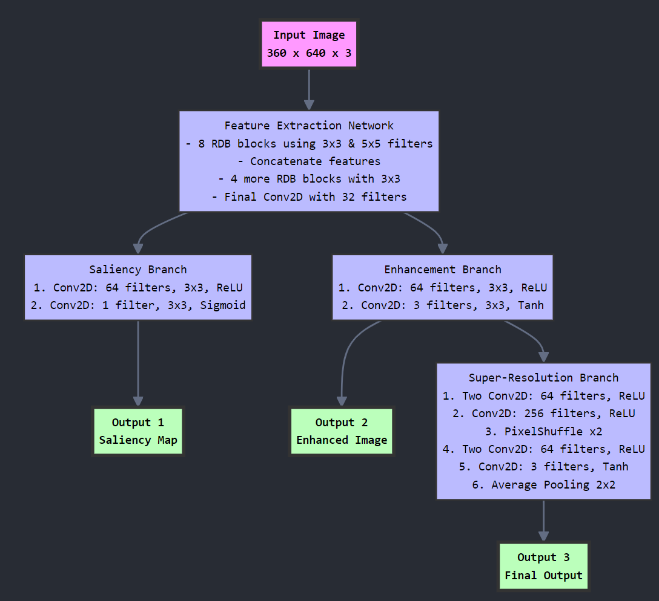
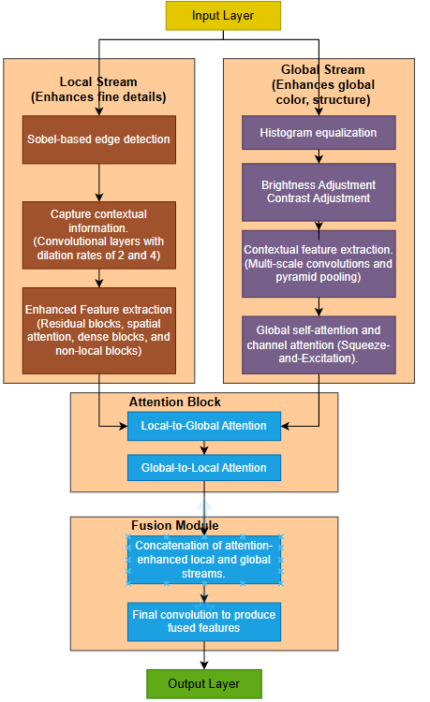
ML Model Architecture
DeepSESR Image Enhancement Model
LDS-Net Image Enhancement Model
Overview
Training from Scratch:
Model was trained from scratch
Network Architecture
Input: Fixed size 360x640x3 underwater images
Three main outputs:
Saliency Map (Attention)
Enhanced Image
Final Super-resolved Output
Core Components
Feature Extraction Network:
8 RDB blocks (3x3 & 5x5 filters)
Concatenation layer
4 additional RDB blocks (3x3)
Bottleneck: 32 filters (1x1 Conv)
Processing Branches:
1. Saliency Branch:
64 filters (ReLU)
1 filter output (Sigmoid)
2. Enhancement Branch:
64 filters (ReLU)
3 filters output (Tanh)
3. Super-Resolution Branch:
Multiple 64-filter layers
PixelShuffle upscaling
Final 3-channel output
Overview
Input Layer:
Takes in the raw input image for processing.
Local Stream (Enhances Fine Details):
Sobel-based edge detection
Contextual feature extraction using dilated convolutions (rates 2 & 4).
Enhanced features via residual, spatial attention, dense, and non-local blocks.
Global Stream (Enhances Global Color and Structure):
Histogram equalization for color balancing.
Brightness and contrast adjustments.
Contextual feature extraction with multi-scale convolutions and pyramid pooling.
Global self-attention and channel attention (Squeeze-and-Excitation).
Attention Block:
Local-to-Global and Global-to-Local attention exchange for improved feature integration.
Fusion Module:
Concatenates local and global features.
Final convolution generates the enhanced output image.
Output:
Produces an enhanced image with improved clarity, color balance, and detail.
Processing Flow​
Input → Feature Extraction → Three Parallel Outputs​
├─► Saliency Map​
├─► Enhanced Image​
└─► Enhanced → Super-Resolution​
Technical Highlights​
Consistent use of Conv2D layers​
Strategic activation functions:​
ReLU for intermediate layers​
Sigmoid for saliency​
Tanh for image outputs​
Efficient feature reuse​
Integrated enhancement-SR pipeline​

Slide 10
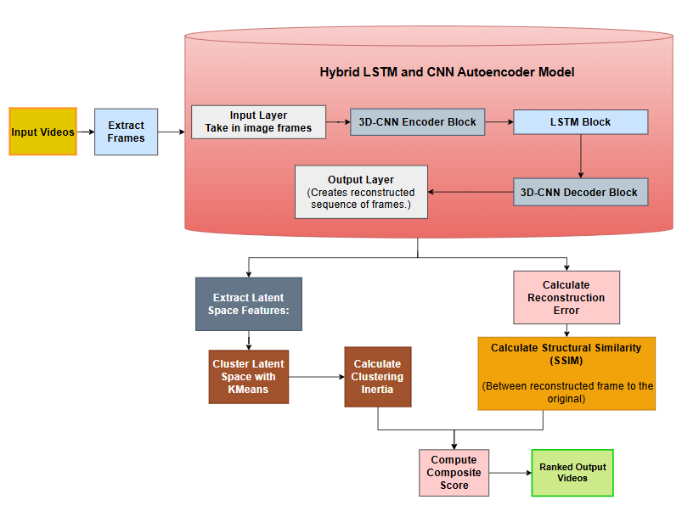
ML Model Architecture
Best Video Selection Model : Hybrid 3D-CNN and LSTM Autoencoder with Composite Quality Score calculation
Processing Flow
Extract Frames:
The video is split into individual frames, resized to 128x128 to match the autoencoder’s input shape.
Create Sequences of Frames:
Overlapping sequences are generated from the frames (sequence length = 10) to enable the LSTM in the autoencoder to capture temporal patterns.
Reconstruction Using Autoencoder:
The autoencoder predicts the reconstructed frames from the sequences. These reconstructions are compared to the original frames.
3D-CNN (Convolutional Neural Network): Extracts spatial features from sequences of frames (video data).
LSTM (Long Short-Term Memory Network): Captures temporal dependencies across sequences of frames.
Calculate Reconstruction Error:
Mean Squared Error (MSE) is used to measure the difference between the original and reconstructed sequences:
Calculate Structural Similarity (SSIM):
SSIM measures how structurally similar the reconstructed frames are to the original ones. Higher SSIM indicates better reconstruction quality.
Extract Latent Space Features: The encoder part of the autoencoder extracts latent features from the input sequences, capturing the core patterns in a compressed form.
Cluster Latent Space with KMeans:
KMeans clustering is performed on the latent vectors. The inertia value (sum of squared distances from points to cluster centers) indicates how well-separated the clusters are.
Compute Composite Score: The final composite score is calculated using three metrics:
Reconstruction Error: Lower is better.
SSIM Score: Higher is better (negated for minimization).
Clustering Inertia: Lower inertia suggests better separation in the latent space.
Perturbation to Avoid Identical Values:
A small random noise is added to each metric to avoid identical values, ensuring smooth ranking.
Ranking of Videos:
All videos are ranked based on their composite scores, with lower scores indicating better-quality videos.

Slide 11
System Performance
The system's performance largely depends on the machine where the Docker containers are running. Currently, this POC project is configured to run on local machines and is set to run on the CPU to avoid errors on systems without a compatible GPU.
As a result, the performance metrics are not optimal. However, the details below reflect the performance when running the Docker containers on a Windows machine with an Intel i7 11th Gen 8-core CPU, with each API call executed in parallel. The performance will improve significantly if the system is deployed in a production environment with GPU support for inference.
Performance Check
Machine: Docker running on a Windows machine with an Intel i7 11th Gen 8-core CPU
Test Video:
Length: 0.9s
Frame Rate: 60 fps
Number of Frames: 54
Resource Utilization
CPU Usage: 99%
Memory Consumption: 80%
Recommendations for Performance Improvement
Port to Cloud-based ML Deployment:
Utilize ML inference services (e.g., AWS SageMaker, Azure ML, or Google AI Platform) for auto-scaling and load balancing,
Distributed Processing: Distribute the processing load across multiple cloud-based nodes to further accelerate the processing of large batches of videos.
Optimize Models for Deployment: Use model optimization techniques such as quantization, pruning, or TensorRT to reduce model size and inference time without compromising accuracy.
ML Model | Inference Time
Sea-Pix-GAN | 14.47 seconds
FUnIEGan | 75.32 seconds
LDS-Net | 99.57 seconds
DeepSESR | 358.99 seconds
Best Video Selection | 3.11 seconds

Slide 12
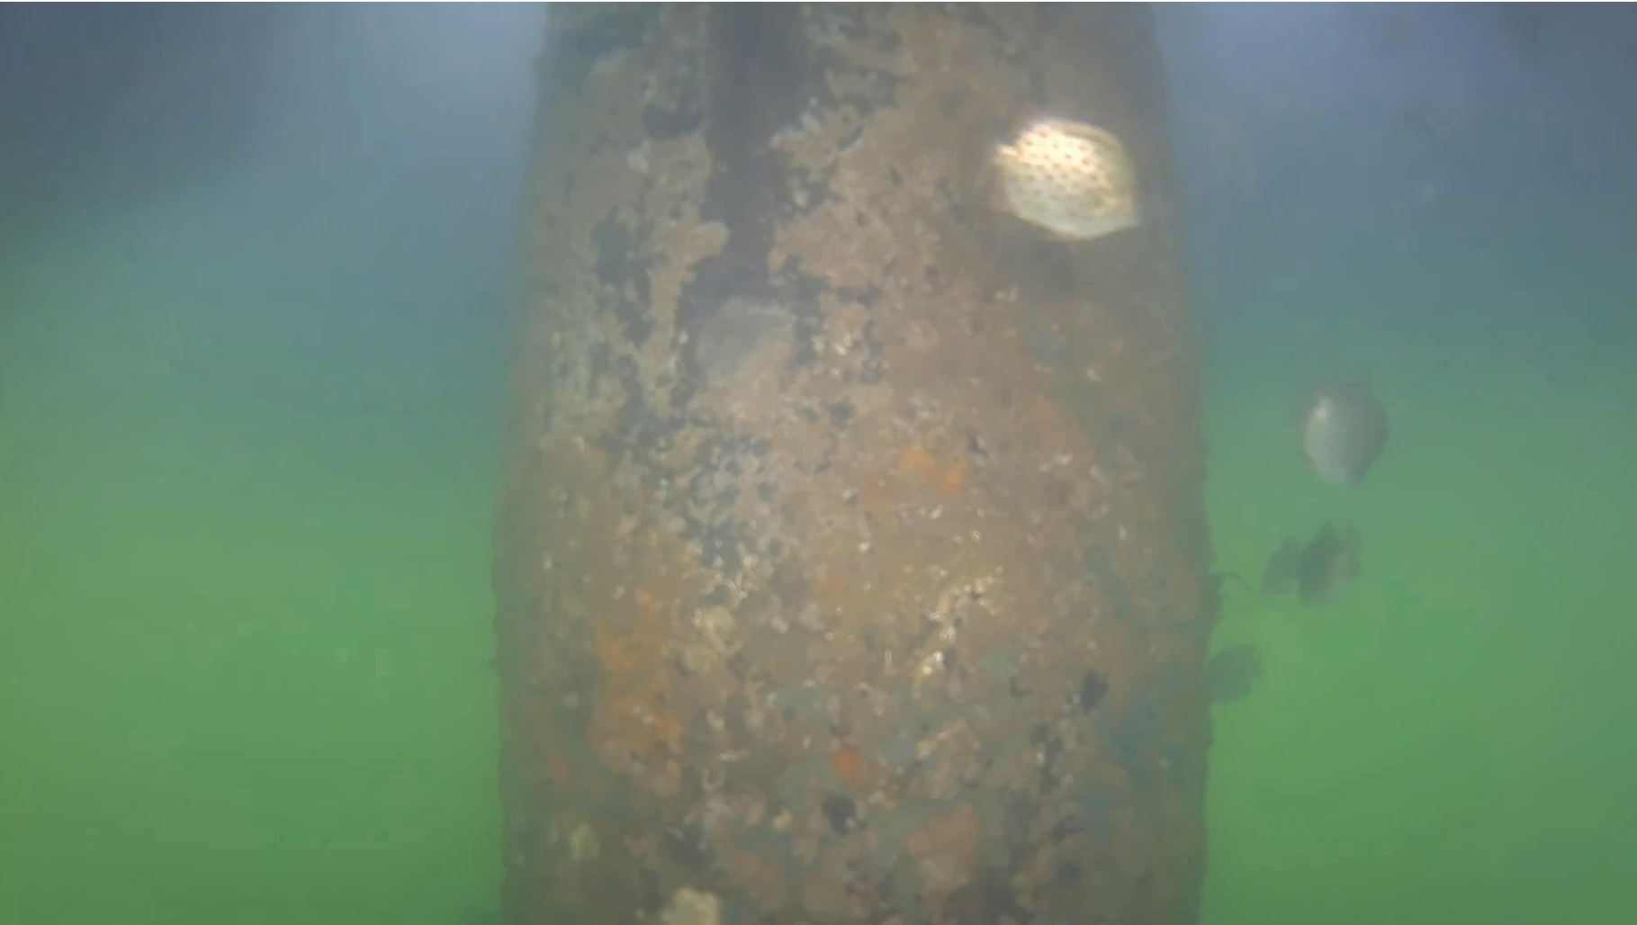
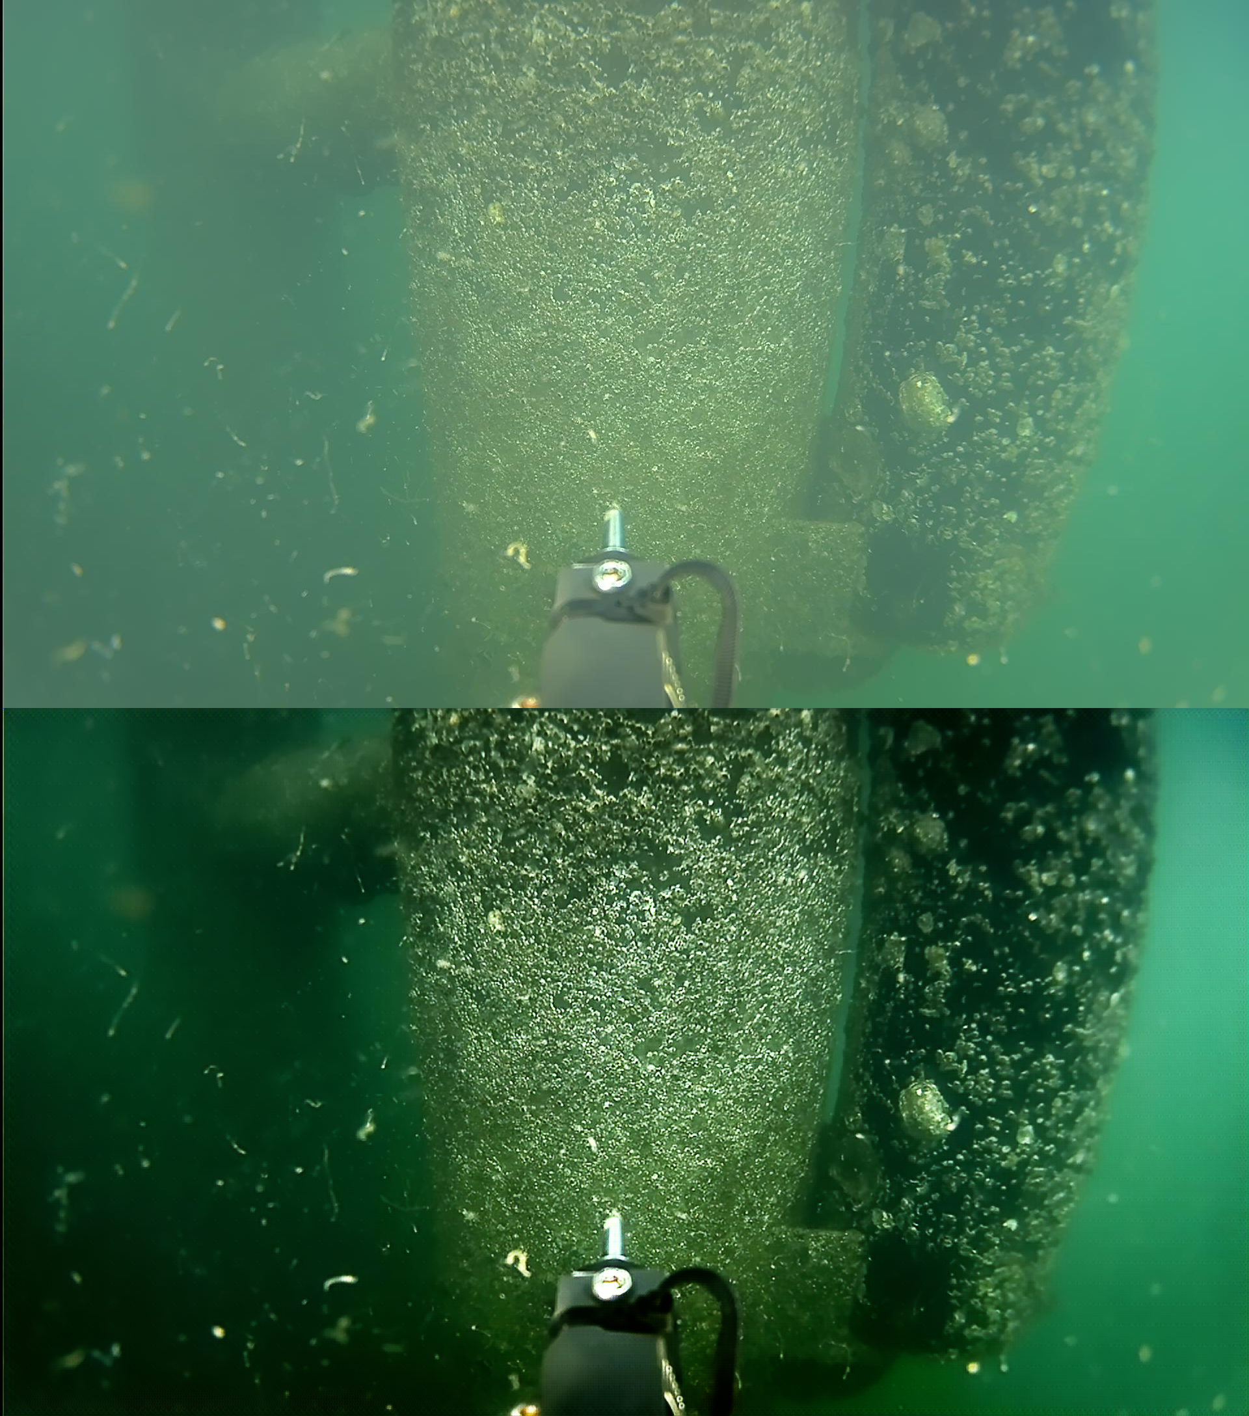
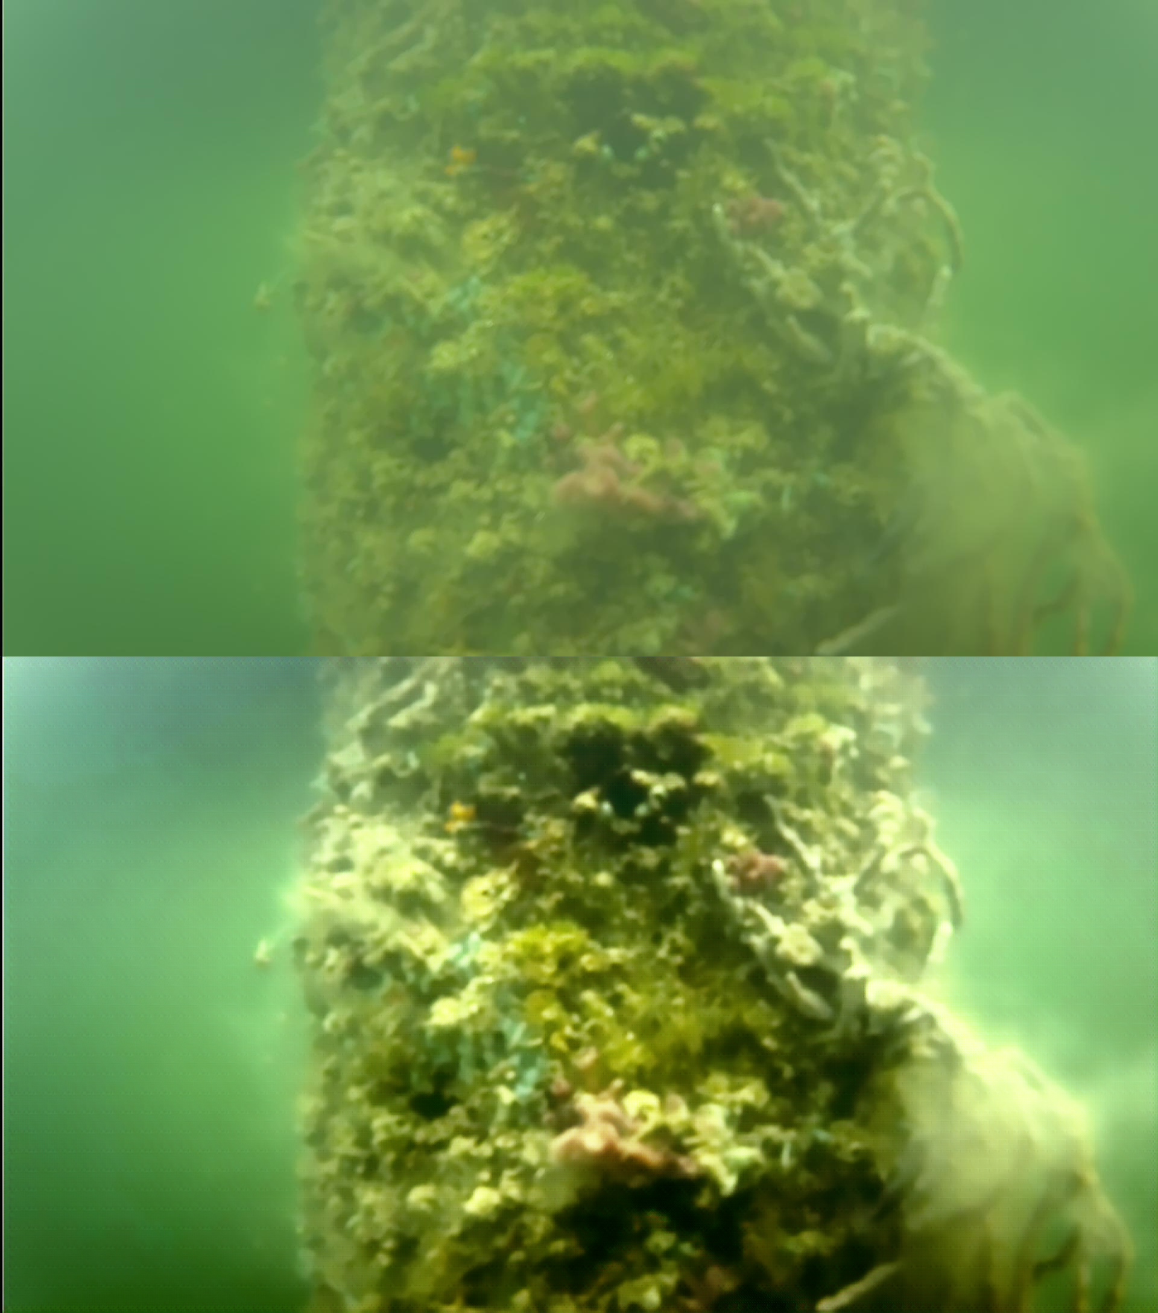

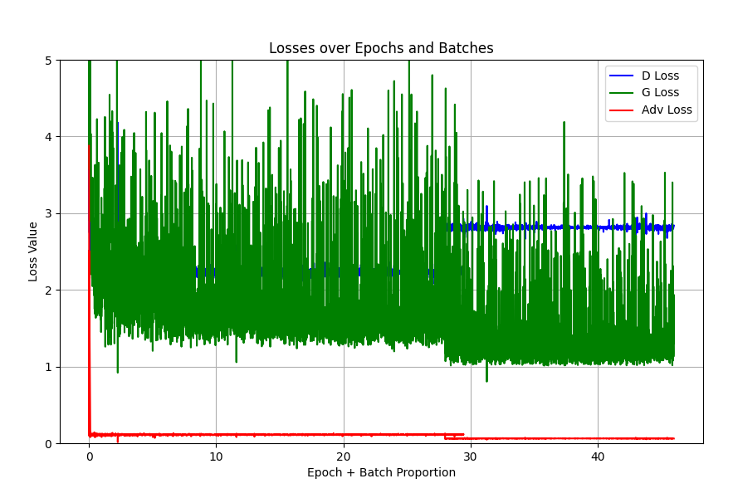
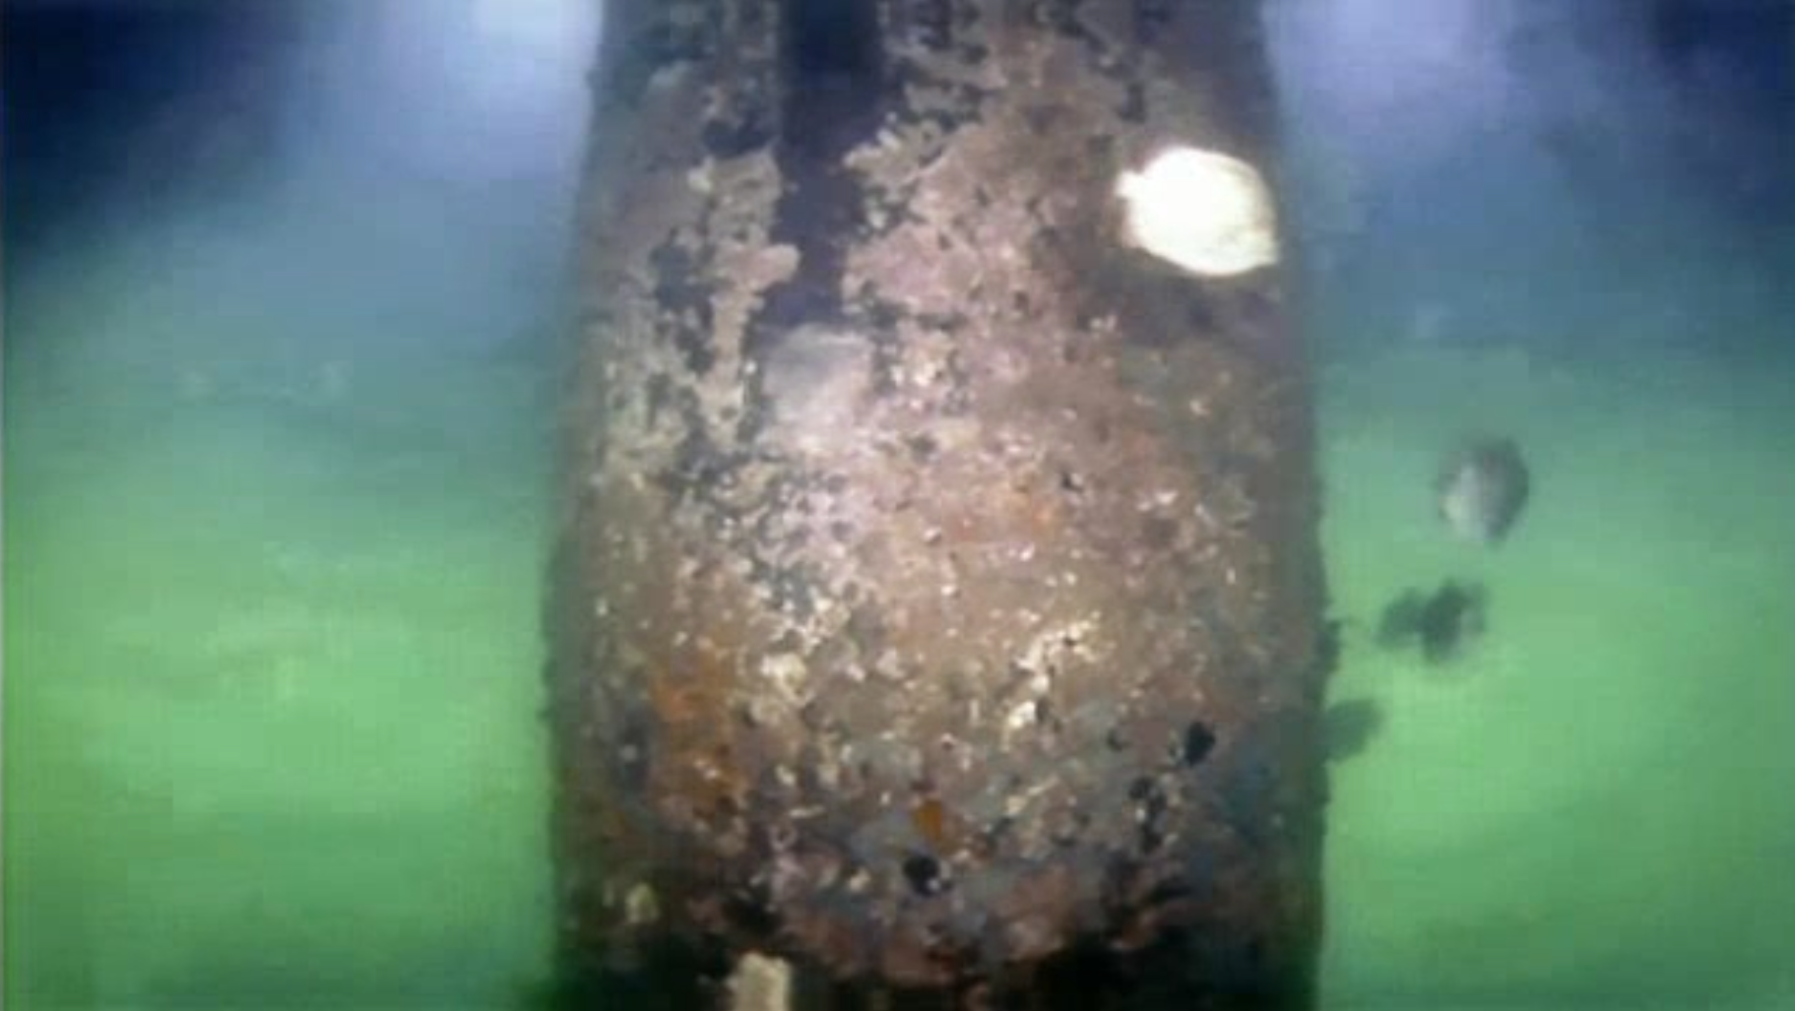
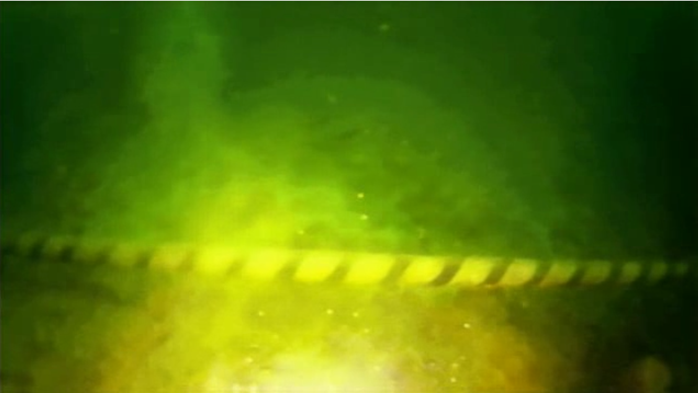
FUnIE-GAN: Model Performance Results
Training Environment: Intel® i9-9900K CPU, NVIDIA RTX 4070 GPU
Loss Graph X axis – represents Each Epoch and Batches Y axis – represents Losses for each case
Top Images – Original & unenhanced images || Bottom Images – Enhanced Image and Video feeds by FUnIE-GAN
Key Performance Metrics
Model Size 28 MB - Optimal for embedded systems
Inference Speed
15 ms per frame average
Training Duration
100 epochs total, convergence at 45 epochs
Validation Results
Successful testing on 7 new video inputs
Strong performance on unseen validation images
Surpassed existing pipeline performance
Demonstrated robust generalization capabilities
Demonstrated best quality performance for HD input (1920*1080)
Final Loss Values
Discriminator Loss:2.840
Generator Loss:1.305
Adversarial Loss:0.061
Future Enhancements
Potential for expanded training dataset
Opportunity to improve edge case handling
Focus on enhanced generalization
Real-time deployment optimization
Conclusion: Model demonstrates excellent real-time performance and deployment feasibility for AUV applications

Slide 13
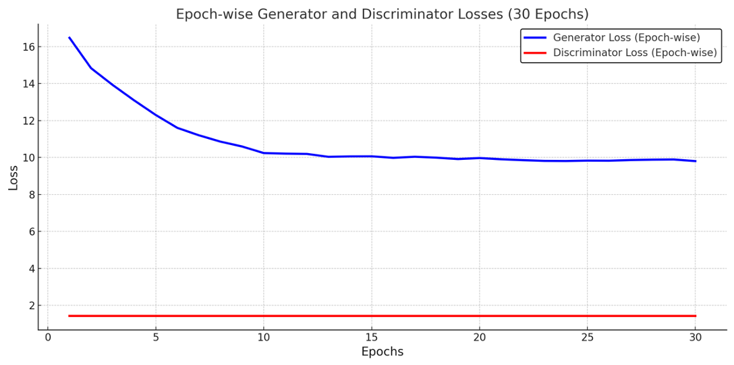
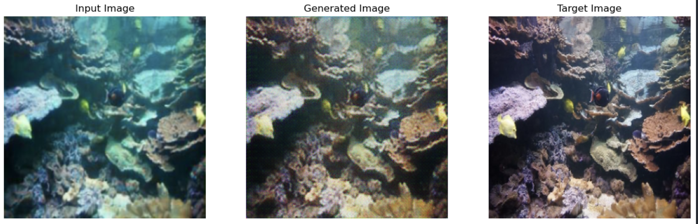
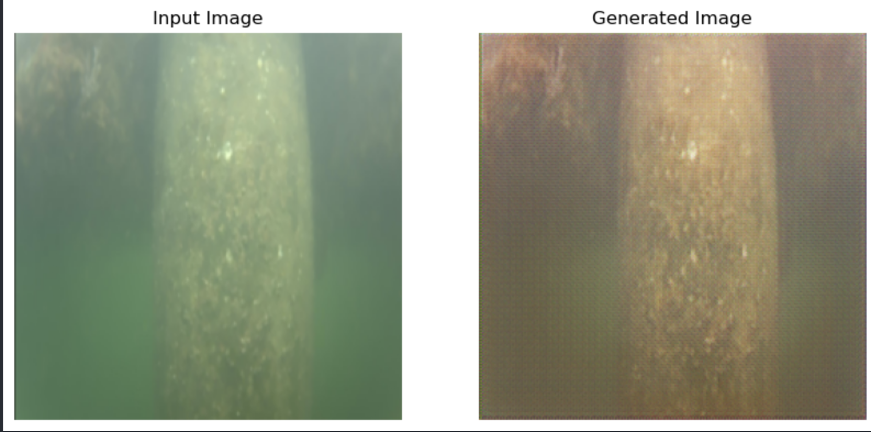
Sea-Pix-GAN: Model Performance Results
Generator Loss:
Shows a gradual decrease over the epochs, indicating improved image generation quality.
Reflects the model’s ability to minimize reconstruction errors and produce realistic images.
Combines adversarial, L1, and perceptual losses for realism and accuracy.
Perceptual loss with VGG19 features emphasizes high-level visual quality.
Discriminator Loss:
Exhibits fluctuations due to adversarial training dynamics, adjusting to generated outputs.
Indicates the model’s capability to distinguish real from generated images using binary cross-entropy.
Early Stopping:
Triggered at 30 epochs, ensuring training halts when no significant improvements are observed.
Loss Analysis:
The combined losses indicate convergence towards achieving both adversarial realism and image quality.
Observations
Generator’s Stability: The generator loss variability indicates that it was effective in producing realistic images for some batches but struggled with others.
Discriminator’s Consistency: The discriminator maintained consistent output, signalling that it was able to reliably classify real versus generated images.

Slide 14
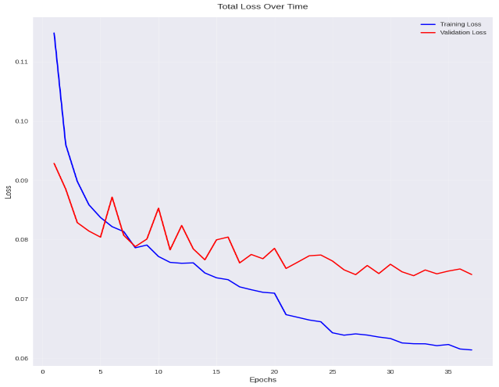
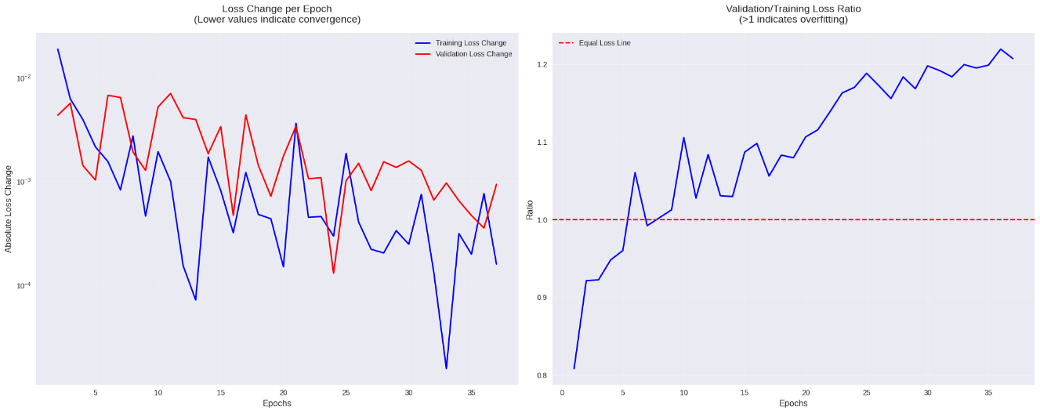

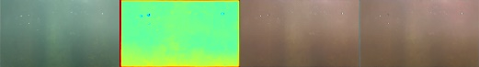
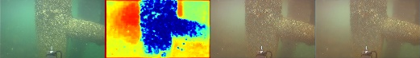
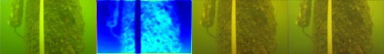

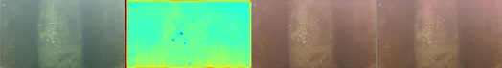
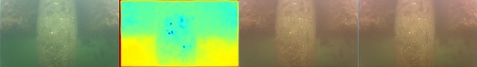

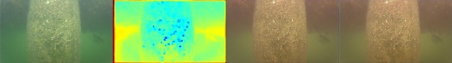
DeepSESR: Model Performance Results
Training Dynamics:
Rapid initial improvement in first 5 epochs
Steady progression with gradual loss reduction
Training loss consistently decreased throughout
Strong early learning phase followed by fine-tuning
Key Observations:
Fast initial convergence
Good overall improvement (46.56%)
Slight overfitting trend after epoch 32
Very stable final epochs (low stability metrics)
Recommendations:
Consider early stopping at epoch 32
Monitor validation/training ratio
Potential for shorter training duration
Could benefit from regularization after epoch 25
Important Metrics:
Initial → Final Values
Training: 0.1149 → 0.0614 (-46.56%)
Validation: 0.0928 → 0.0741 (-20.15%)
Model Stability:
Very stable final convergence (0.000413)
Consistent validation performance
Small oscillations in later epochs
Good generalization up to epoch 32
Optimization Success:
Met training objectives
Achieved significant improvement
Maintained stable learning
Good balance of performance vs. overfitting
Training Summary
Total epochs trained: 37
Initial training loss: 0.1149
Final training loss: 0.0614
Best training loss: 0.0614 at epoch 37
Validation Metrics:
Initial validation loss: 0.0928
Final validation loss: 0.0741
Best validation loss: 0.0739 at epoch 32
Convergence Analysis
Loss stability (last 5 epochs): 0.000413
Validation loss stability: 0.000363
Total loss improvement: 46.56%

Slide 15
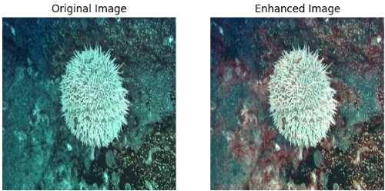
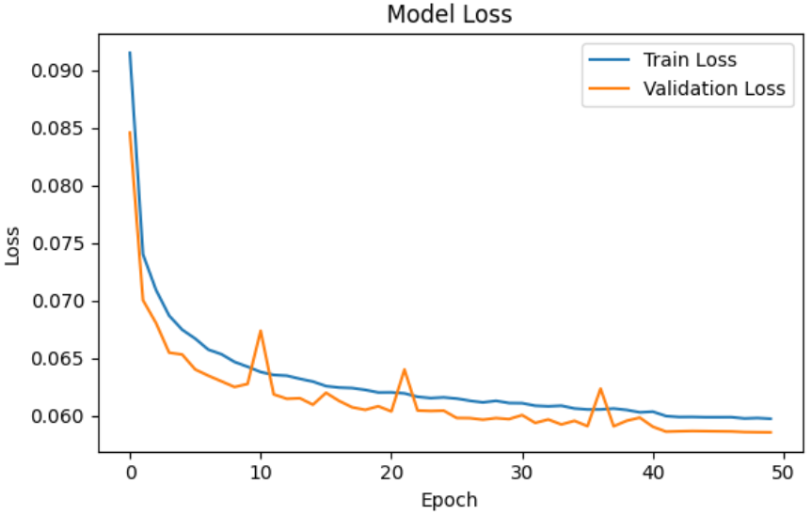
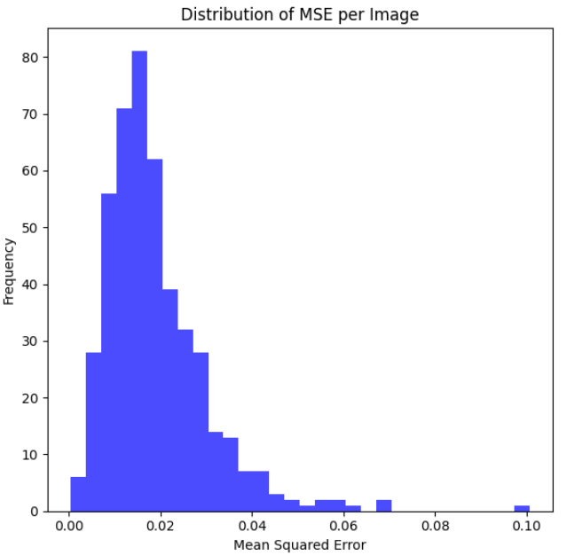
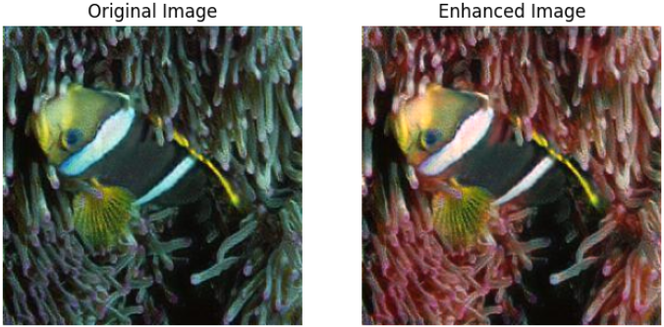
LDS-Net: Model Performance Results
​Training Setup​
​
Dataset :​
Marine Robot Images (From BeeX) and The EUVP dataset (open data)​
​
Training Methodologies​
L2 Regularization​
Gradient Clipping​
Learning Rate Scheduling​
Early Stopping​
Checkpointing​
Monitoring Loss and Metrics​
Batch-wise Data Generation​
​
Objective​
To Minimize the Mean Squared Error (MSE) between the predicted and ground truth outputs.​
​
Training Duration ​
50 epochs total, convergence at 45 epochs ​ ​
Final Model Size ​
35.6 MB ​
Validation Matrix
Evaluation with Test Image set
Visual Comparison of Original Vs Enhanced Image
Loss or mean Squared Error (MSE) vs Epoch:
Both the training and validation losses show a decreasing trend over the epochs, which indicate that the model is learning effectively.
Validation loss is lower than the training loss after initial epochs, indicating good generalization and absence of overfitting.
MSE (Mean Squared Error) over test image set :
The histogram indicates that most of the images have a low MSE value, clustered between 0.00 and 0.02, with very few images exceeding 0.05.
This suggests that the enhanced images, on average, deviate minimally from the ground truth, indicating good performance for most images.
The visual comparison of the original versus enhanced images demonstrates an improvement in overall image quality and fine details, as intended by the LDS-Net model
However, scenarios where there are no images with sharp textures found to be not apt for this model

Slide 16
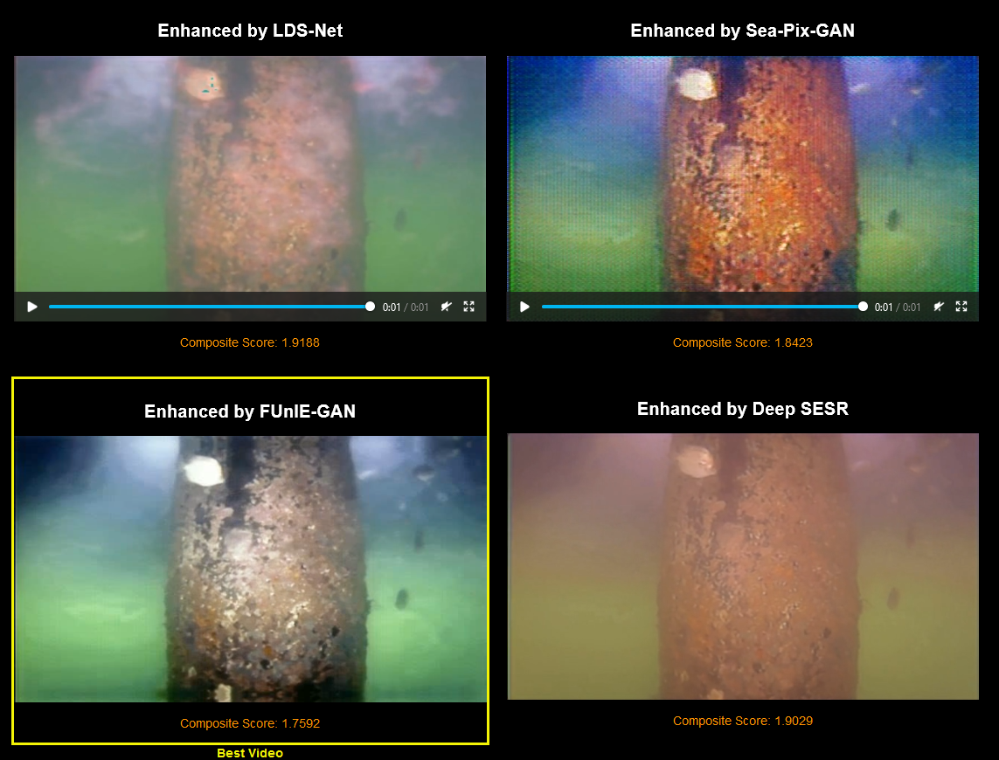
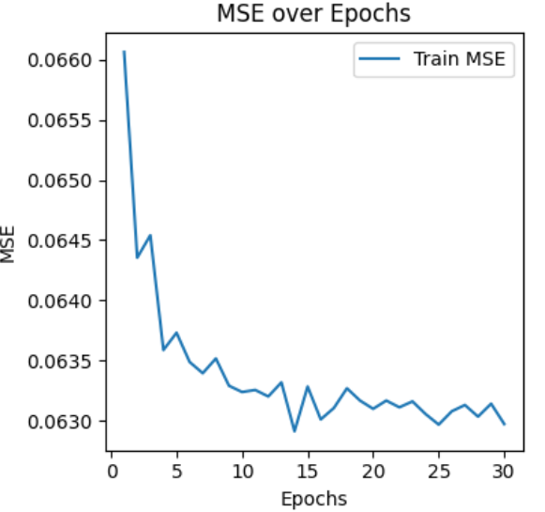
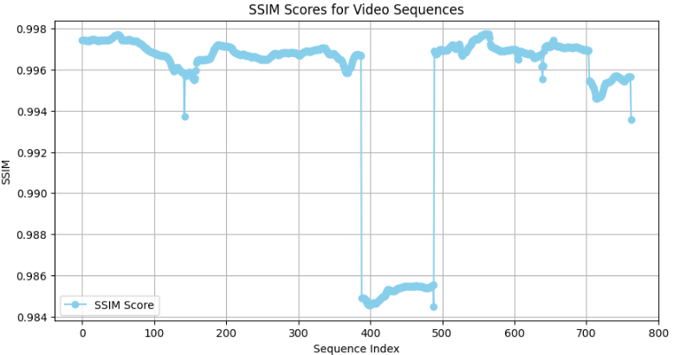
Best Video Selection Model Performance Results
​Training Setup
Dataset :
UOT32 underwater data set from Kaggle (Videos files only)
Underwater Videos from Sponsor BeeX
Training Methodologies
Data Augmentation: Frame shuffling, brightness/contrast adjustments, temporal cropping
Learning Rate: 0.001 with ReduceLROnPlateau callback
Regularization: L2 regularization on CNN and LSTM layers
Objective
Minimize Reconstruction Error for accurate frame reproduction
Improve Clustering Inertia for compact latent space clusters
Reduce Structural Similarity Index (SSIM) between original and reconstructed frames
Training Duration
30 epochs total, convergence at 25 epochs
Final Model Size
1.88 GB
Training Matrix for Hybrid 3D-CNN and LSTM Autoencoder
Evaluation of Hybrid 3D-CNN and LSTM Autoencoder with Test Videos
Visual Comparison of Ranked Videos:
*Each sequence here consists 10 frames. Tolal of 763 sequences (7 videos and 7630 frames)
MSE over Epochs:
Sharp drop in early epochs, stabilizing towards the later ones.
Indicates improved frame reconstruction across training.
SSIM (Structural Similarity Index)
SSIM measures the similarity between original and reconstructed frames.
Most SSIM scores are above 0.98 (Close to 1), which suggests the model is performing well overall.
A visual comparison confirms that the video with the lowest composite score appears to be the best to human eyes too

Slide 17
Recommendations
Model Algorithmic Improvement
FUnIEGan:
Enhance low-light handling with improved generator-discriminator architecture.
Use perceptual/content loss for better visual quality.
Inclusion of more diverse datasets for further improving the generalization capability
Sea-Pix-GAN:
Optimize GAN convergence with advanced optimizers (e.g., RAdam).
Add Spectral Normalization: Integrate spectral normalization in the encoder and decoder layers to stabilize GAN training, improve convergence, and enhance generated image quality.
Use Multi-Scale Discriminator: Introduce a multi-scale discriminator to capture both global and local features, resulting in more detailed and realistic underwater images.
DeepSESR:
Incorporate sequential, standalone modular design like distinct FENet module, dedicated AAN module and Independent enhancement module
For memory efficiency implement progressive channel expansion and removing the bottleneck compression while maintaining feature richness
Implement variable input resolution support by removing fixed 360×640×3 constraint by implementing dynamic resizing and adaptive feature extraction
LDS-Net:
Leverage ensemble learning with potential other models for better output.
Apply transfer learning with pre-trained models for quicker enhancement rather than training from scratch. (Currently no compatible pretrained model found to be available for our specific purpose)
Best Video Selection (Hybrid 3D-CNN and LSTM Autoencoder):
Incorporate user feedback into best Video Selection model when there are sufficient data. (Current System already capture and store this data for future improvement )
Performance Improvement​ ​
Port to Cloud-based ML Deployment:​Migrate the inference workload to cloud platforms like AWS, Azure, or Google Cloud that offer GPU/TPU-enabled instances for faster and more efficient processing.​
Optimize Models for Deployment: For model that take long inference time such as DeepSESR, use model optimization techniques such as pruning, or TensorRT to reduce model size and inference time without compromising accuracy.

Slide 18
Conclusion
Project Summary
System Developed: Comprehensive underwater video enhancement system using deep learning models.
Challenges Addressed: Color distortion, motion blur, and noise in underwater imaging.
Models Used: CNN, GAN, and hybrid 3D-CNN with LSTM for best video selection.
Outcome: Enhanced visual clarity and object identification for AUV applications.
Impact​
​
Demonstrates the potential of deep learning in underwater exploration, providing a solid foundation for future advancements in marine technology.​
Delivers a working POC to our sponsoring company, BeeX, for further evaluation and development.

Slide 19


